Slide 1

Final Year Project Proposal Defense Presentation
Non-Invasive Mobile Blood Glucose Spikes Monitoring System

Slide 2
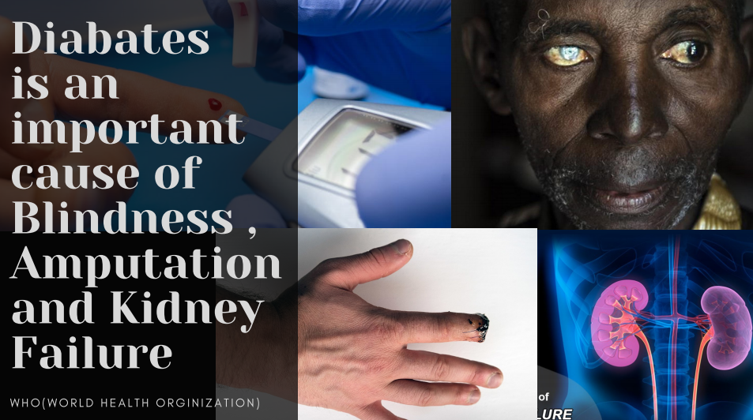
Do You Know??
[3]

Slide 3
Presentation Flow
Introduction
Problem Statement
Project objective
Design Methodology
Block Diagram
Hardware Modules
Application Areas
Time and cost Analysis
References
Department of Electrical Engineering, FET, International Islamic University Islamabad

Slide 4
Introduction
Non Invasive Glucose meter
Diabetes
Get rid of Test strips(common invasive technique)
Smart Device
Technique of non invasive method

Slide 5
Literature review
Techniques:
Optical Coherence Tomography [4]
Fluoresce [4]
Optical polarimetry [4]
MIR Spectroscopy [4]
NIR Spectroscopy [4], [5]
Raman Spectroscopy [4]
Photoacoustic Spectroscopy PAS [4], [6]

Slide 6
Problem Statement
Test strip method
Painful
Non-Compliance
Expensive
Not Always Accurate
Cause Infection

Slide 7
Objectives
Accuracy and Economical
Mobile App
Patient’s Information Retrieval
Portable
Recommend Insulin
Diet Plan & Workout

Slide 8
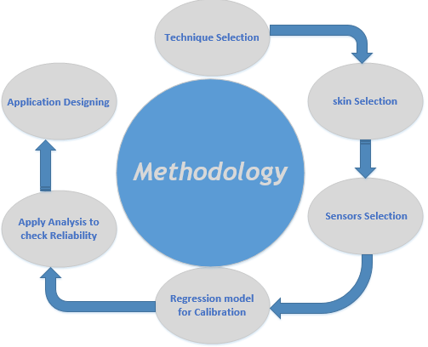
Design Methodology
Figure 1. Design Methodology of Blood Glucose Monitoring system

Slide 9
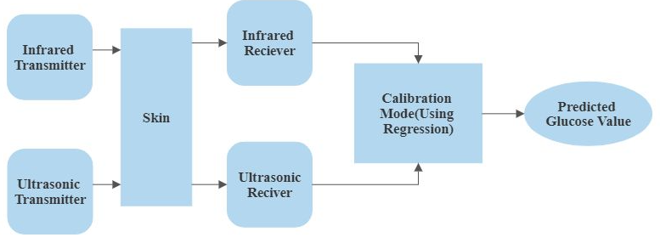
Block Diagram
[4]
Figure 2. Blocked Diagram of Blood Glucose Monitor Meter

Slide 10
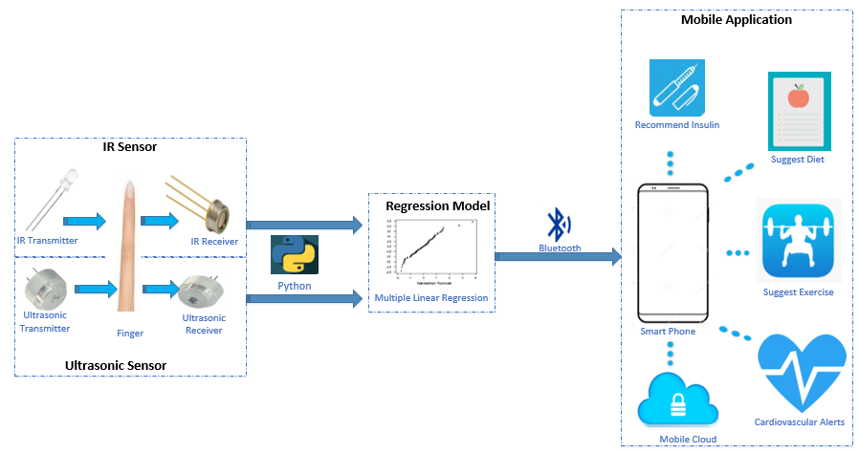
Hardware Modules
Figure 3. Hardware Modules of Blood Glucose Monitoring System

Slide 11
Application Areas
Clinical procedure for Safer Patient Care
Self Testing
Used at any Place
Scope
Non Invasive Detection
Without clinically and commercially viable product
Different techniques

Slide 12
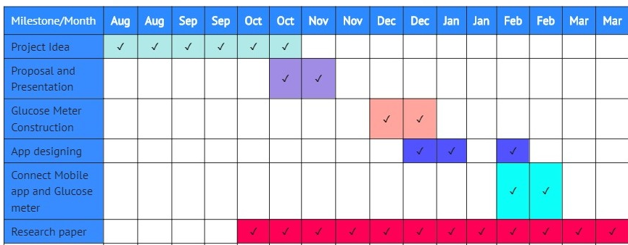
Time and cost Analysis
Table 1. Timeline of Proposed Project
Cost Analysis
Cost of project will be 20k to 30k.
Try to make it as cheap as possible.

Slide 13
References
[1] “Latest Advancements in Diabetes and Looking Towards the Future,” Accessed on: Nov. 11, 2020. [Online]. Available : http://mydario.com/diabetes-advancements/
[2] “Diabetes Research Network (DRN),” Accessed on: Nov. 12, 2020. [Online]. Available: https://www.diabetes.co.uk/research/diabetes-research-network.html
[3] “10 facts on diabetes,” Nov , 2020. Accessed on: Nov. 11, 2020. [Online]. Available: https://www.who.int/features/factfiles/diabetes/en/#:~:text=Fact%209%3A%20Diabetes%20is%20an,overall%20risk%20of%20dying%20prematurely
[4] Abu Asaduzzaman, Soumyashree Samadarsinee, and Kishore K. Chidella, " Simulating Multisensor Noninvasive Blood Glucose Monitoring Systems ", Wichita State University Wichita, Kansas, USA, pp.3, 2016
[5] R.A. Buda and M. Mohd. Addi, “A Portable Non-Invasive Blood Glucose Monitoring Device ”, IEEE Conference on Biomedical Engineering and Sciences, pp no. 2-5, 2014
[6] Fundamentals of FTIR Analysis, "ABC's of Photoacoustic Spectroscopy”, available on-line at: https://www.shimadzu.com/an/service-support/technical-support/analysis-basics/ftirtalk/talk7.html, (accessed on 10/15/2020)

Slide 14


